Slide 1
Pre-Live Session 3
Ben Goodwin

Slide 2
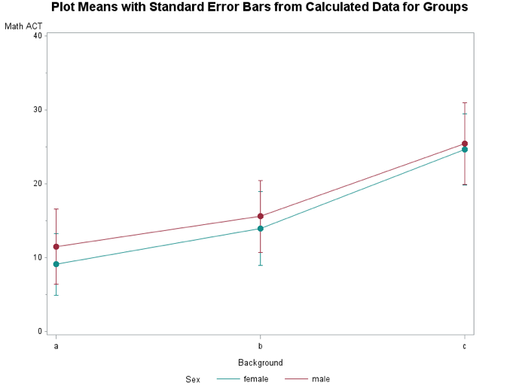
Discussion 1
What type of model (additive or nonadditive) do you think most appropriately fits this data set?
Based on the interaction plot in SAS, there is no visual evidence to support a significant interaction.
Based on MEANS procedure, at first glance, it looks as though the average of group C is the highest. Whether this difference is significant or not is not available from MEANS.
I think that the additive model most appropriately fits
The interaction isn’t significant, and no visual evidence of interaction
There are better indicators of predictors for higher ACT scores.
What are each of the three tests telling us? How do these tests correspond back to our visualization plot?
Type III are each adjusted for all other effects in the model, regardless of order. So type III tables evaluate the contribution of each factor after considering the contributions of other factors in the model.
The type III model has reduced or equal error terms in all three predictors.

Slide 3
Discussion 2
The first parameter B v A, is obvious and tells difference in mean ACT score B v A, the estimate itself, the standard error, t-value and P-value with score as the outcome variable.
The second parameter A v C tells us the difference in mean ACT score A v C, the estimate itself, the standard error, t-value, and P-value associated with score as the outcome variable.
The third parameter A v B tells us the difference in mean ACT score A v B, the estimate itself, the standard error, t-value, and P-value associated with score as the outcome variable.
I found the third one difficult to determine, looking at the SAS code I see -1,1; accounting for two parameters, but not the third.

